Slide 1
ESFP-II
BOOKSHOP INVENTORY

Slide 2
OUR AIM OF THE PROJECT
Under any particular book shop, there are various number and types of books available and it is sometimes even difficult for the book shop owner to remember the details of any particular book. With this new book shop system, book shopkeeper will find easier to perform all the operations which are needed for their daily business transactions. As there will be a common system and screen for all types of users but to perform operations related to admin part, that person should have a valid log in id and password.
If any customers have purchase any book, then they have to just the correct option and enter the name of the book which they want to book along with total number of books. If the book will be available in the shop, it will generate the final bill which is to be paid by the customers at the cash counter and receive that particular book. If no such book will be available, then appropriate message will be displayed for the users and expected date by which this book will be available within the shop. Admin will have the responsibility to add, delete and modify records related to book such as book name, quantity available, price per book etc.Under any particular book shop, there are various number and types of books available and it is sometimes even difficult for the book shop owner to remember the details of any particular book. With this new book shop system, book shopkeeper will find easier to perform all the operations which are needed for their daily business transactions. As there will be a common system and screen for all types of users but to perform operations related to admin part, that person should have a valid log in id and password.
If any customers have purchase any book, then they have to just the correct option and enter the name of the book which they want to book along with total number of books. If the book will be available in the shop, it will generate the final bill which is to be paid by the customers at the cash counter and receive that particular book. If no such book will be available, then appropriate message will be displayed for the users and expected date by which this book will be available within the shop. Admin will have the responsibility to add, delete and modify records related to book such as book name, quantity available, price per book etc.

Slide 3
THE HEADER FILE
#include <iostream>
#include <string.h>
#include <stdlib.h>

Slide 4
USE OF THE PROGRAM
TO ENTRY OF THE BOOK.
TO BUY ANY BOOK.
TO SEARCH OF THE BOOK.
TO EDIT THE BOOK.

Slide 5
THE CONCEPTS IN THE WHOLE PROJECT
CLASS AND OBJECT.
IF ELSE.
STRING.
CASE STATEMENT.

Slide 6
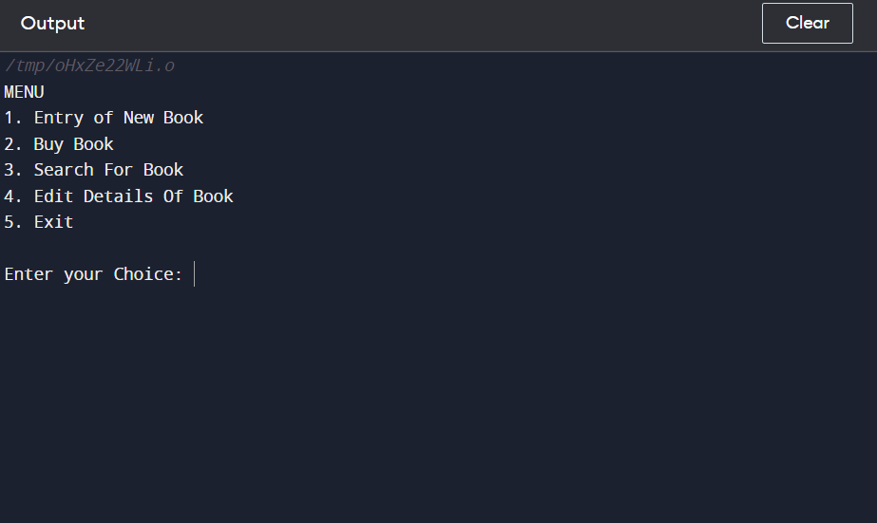

Slide 7
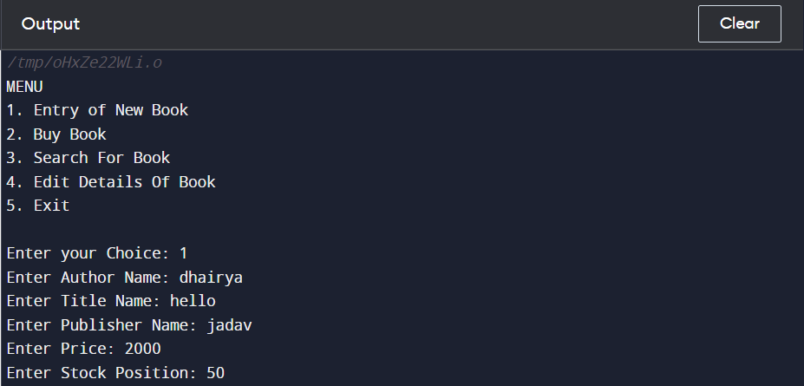

Slide 8
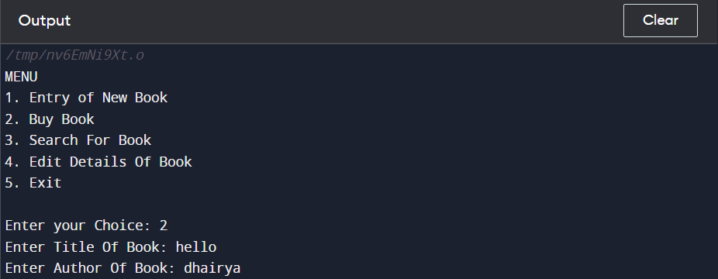

Slide 9


Slide 10
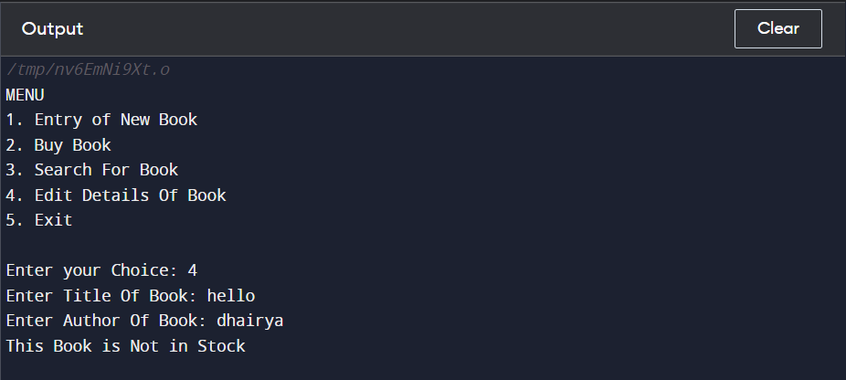

Slide 11
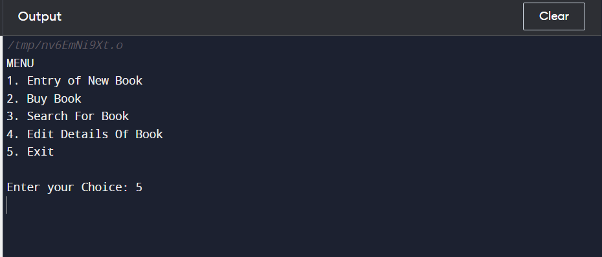

Slide 12
THANK YOU

